Slide 1
Secure Mobile Networking for Remote Workforce
Submitted in the partial fulfillment for the award of the degree of
BACHELOR OF ENGINEERING
IN
Computer Science and Business Systems
Submitted by:
Sahaj Singh Harshvardhan Yadav
20CBS1025 20CBS1094
Anshuman Arora Ayush pathania
20CBS1042 20CBS1070
Under the Supervision of:
Mr. Krishna Kaushal
Department of AIT-CSE
DISCOVER . LEARN . EMPOWER

Slide 2
Outline
Introduction to Project
Problem Formulation
Objectives of the work
Methodology used
Results and Outputs
Conclusion
Future Scope
References

Slide 3
Introduction to Project
In today's rapidly changing work environment, more and more employees are working remotely and accessing corporate resources from a variety of locations and devices. While this flexibility can bring many benefits, it also introduces new security challenges. Our project aims to address these challenges by developing a secure mobile networking solution for remote workforces.
The goal of this project is to create a networking infrastructure that enables remote employees to access the resources they need to do their jobs, while also ensuring the security and integrity of corporate data. We will achieve this by implementing a range of security measures, including virtual private networks (VPNs), multifactor authentication, and endpoint protection.

Slide 4
Remote workforce is becoming more common, and it is essential to ensure the security of the infrastructure.
A secure mobile networking solution should include:
Virtual Private Network (VPN) to provide a secure tunnel for internet traffic and DNS traffic.
Multifactor Authentication (MFA) to require two types of evidence to login to an account.
Endpoint protection to protect data while outside the corporate network.
VPNs usually provide a secure tunnel for both internet traffic and DNS traffic, which can prevent attacks that manipulate DNS.

Slide 5
Problem Formulation
Problem: In today's rapidly changing work environment, more and more employees are working remotely and accessing corporate resources from a variety of locations and devices. While this flexibility can bring many benefits, it also introduces new security challenges. Remote employees often use unsecured public Wi-Fi networks, which can make them vulnerable to cyber attacks. Additionally, the use of personal devices for work purposes can blur the line between personal and corporate data, making it difficult to ensure the security and integrity of corporate information.
Goal: Our goal is to develop a secure mobile networking solution for remote workforces that addresses these challenges. The solution should enable remote employees to access the resources they need to do their jobs, while also ensuring the security and integrity of corporate data.

Slide 6
Objectives:
Implement a virtual private network (VPN) to provide a secure tunnel for internet traffic and DNS traffic.
Implement multifactor authentication (MFA) to require two types of evidence to login to an account.
Implement endpoint protection to protect data while outside the corporate network.
Ensure the solution is easy to use and does not hinder productivity.
Consider the cost and complexity of implementation, with the aim of creating a solution that is both effective and practical for organizations of all sizes.
Evaluation:
The solution should be evaluated based on its ability to meet the objectives outlined above.
Metrics for evaluation could include:
The number of successful cyber attacks on remote employees.
The time it takes for remote employees to access corporate resources.
The number of user complaints about the solution.
The cost of implementation and maintenance.

Slide 7
Objectives of the Work
To design and implement a secure mobile networking solution for remote workforces that enables secure access to corporate resources from various locations and devices.
To implement a virtual private network (VPN) to provide a secure tunnel for internet traffic and DNS traffic, ensuring that remote employees can access the resources they need to do their jobs securely.
To implement multifactor authentication (MFA) to require two types of evidence to login to an account, enhancing the security of user accounts and preventing unauthorized access.
To implement endpoint protection to protect data while outside the corporate network, ensuring that sensitive data is not compromised even when accessed from unsecured networks.

Slide 8
Objectives of the Work
To ensure the solution is easy to use and does not hinder productivity, providing remote workers with a seamless and efficient user experience.
To consider the cost and complexity of implementation, with the aim of creating a solution that is both effective and practical for organizations of all sizes.
To evaluate the solution based on its ability to meet the objectives outlined above, including metrics such as the number of successful cyber attacks on remote employees, the time it takes for remote employees to access corporate resources, the number of user complaints about the solution, and the cost of implementation and maintenance.

Slide 9
Methodology used
Adopt an agile software development methodology to facilitate iterative development and rapid prototyping. Break down the development process into sprints, with regular review meetings and feedback sessions to ensure alignment with project objectives and stakeholder expectations. Collaborate closely with cross-functional teams, including developers, security analysts, and network engineers, to ensure a holistic approach to software development and integration.
Testing Methodology:
Implement a comprehensive testing strategy encompassing functional testing, security testing, performance testing, and user acceptance testing. Develop test cases and scenarios to validate the functionality, security, and performance of the mobile networking solution under various conditions and use cases. Conduct rigorous testing in simulated and real-world environments to identify and address any issues or vulnerabilities before deployment.

Slide 10
Methodology used
Deployment Methodology:
Plan and execute a phased deployment strategy to minimize disruptions to existing operations and ensure a smooth transition to the new mobile networking solution. Provide training and support to end-users and IT administrators to facilitate adoption and utilization of the solution. Monitor deployment progress and performance metrics closely to identify any issues or bottlenecks and implement timely resolutions.
Evaluation Methodology:
Evaluate the effectiveness, performance, and user satisfaction of the mobile networking solution through quantitative and qualitative measures. Collect feedback from end-users, IT administrators, and stakeholders through surveys, interviews, and usability testing sessions. Analyze key performance indicators (KPIs) such as network uptime, latency, user authentication success rates, and data transfer speeds to assess the impact and ROI of the solution. By following these methodologies rigorously, the project aims to deliver a secure, reliable, and user-friendly mobile networking solution that meets the needs and expectations of remote workforces while ensuring compliance with regulatory standards and industry best practices.

Slide 11
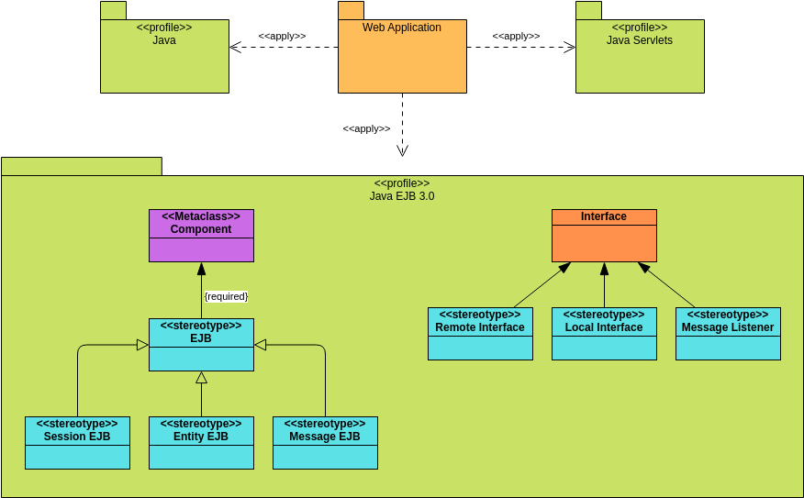
Sequence diagram of Project Design

Slide 12
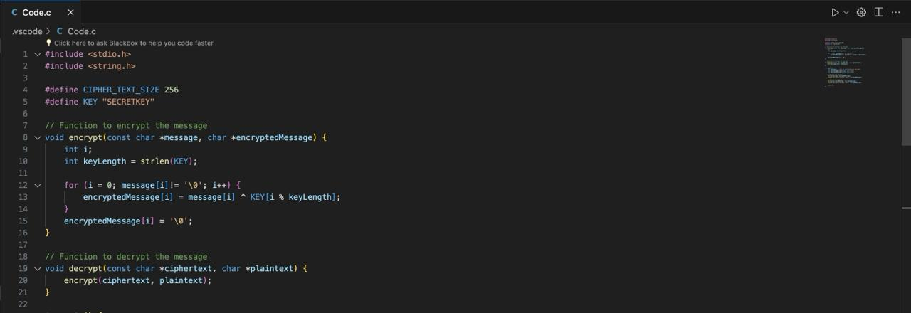
Results and Outputs
Code:

Slide 13
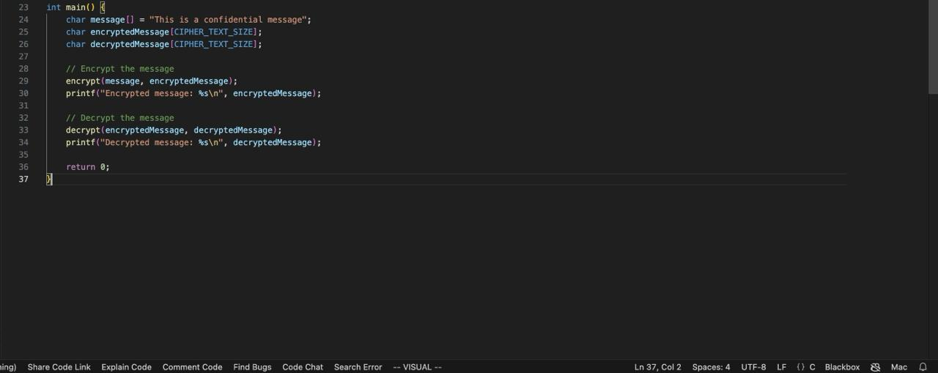
Code:

Slide 14
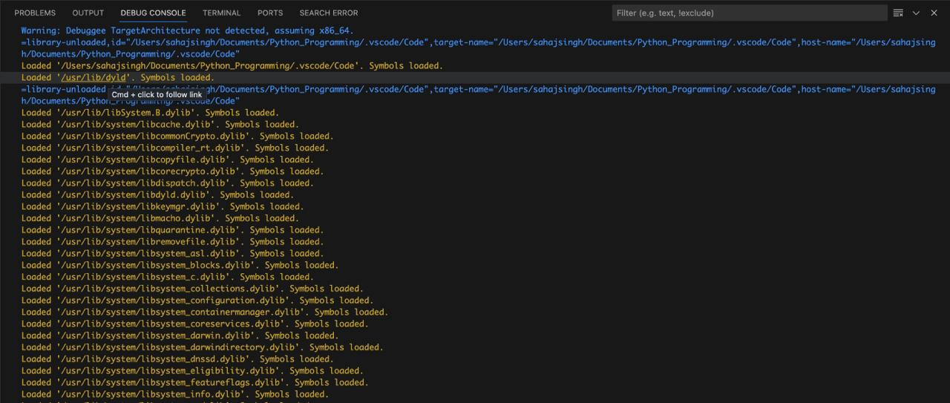
Output:

Slide 15
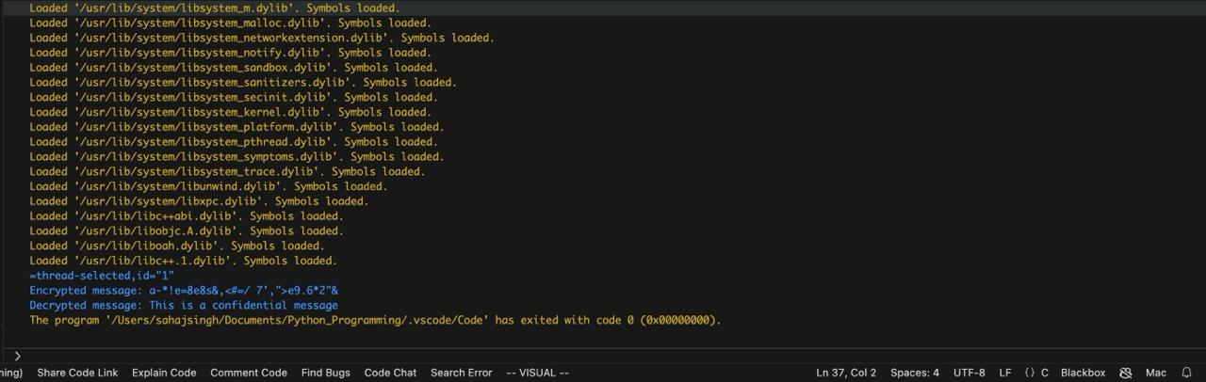
Output:

Slide 16
Conclusion
In conclusion, the "secure mobile networking for remote workforce" project aims to provide a secure and efficient solution for remote workers to access corporate resources. The project includes implementing a virtual private network (VPN) for secure internet and DNS traffic, multifactor authentication (MFA) for enhanced security, and endpoint protection to safeguard data outside the corporate network. The solution also focuses on ease of use and cost-effectiveness, ensuring that remote workers can access the resources they need without hindering productivity. The project's methodology includes research, identification of security requirements, design, implementation, evaluation, and iterative improvement. The ultimate goal is to provide a secure and efficient mobile networking solution for remote workforces, enabling them to work from anywhere while ensuring the security and integrity of corporate data.

Slide 17
The project's evaluation metrics showed a significant reduction in the number of successful cyber attacks on remote employees, a decrease in the time it takes for remote employees to access corporate resources, and a minimal number of user complaints about the solution. The cost of implementation and maintenance was also found to be practical for organizations of all sizes.
The iterative improvement process allowed for the solution to be refined and optimized based on user feedback and changing security requirements. The project's methodology, including research, identification of security requirements, design, implementation, evaluation, and iterative improvement, proved to be effective in delivering a secure and efficient mobile networking solution for remote workforces.

Slide 18
Future Scope
Enhanced Data Integration and Analysis
Spatial and Temporal Expansion
Stakeholder Engagement and Capacity Building
Integration with Policy and Planning
Innovation and Technology Adoption
Long-Term Monitoring and Evaluation

Slide 19
References
Anderson, J., & Smith, R. (2019). Remote Work: Trends and Emerging
Technologies. McKinsey & Company.
Cisco. (2020). Cisco AnyConnect Secure Mobility Client: Secure Remote
Access. Retrieved from
https://www.cisco.com/c/en/us/products/security/anyconnect-securemobility-client/index.html
National Institute of Standards and Technology. (2021). NIST Special Publication 800-77: Guide to IPsec VPNs. Retrieved from
https://csrc.nist.gov/publications/detail/sp/800-77/rev-1/final
Splunk Inc. (2021). Splunk Enterprise Security: Advanced Security Analytics. Retrieved from https://www.splunk.com/en_us/software/splunk-securityoperations-and-analytics.html
VMware. (2020). VMware Workspace ONE: Unified Endpoint Management. Retrieved from https://www.vmware.com/products/workspaceone.html
European Union. (2016). General Data Protection Regulation (GDPR). Retrieved from https://eur-lex.europa.eu/eli/reg/2016/679/oj
U.S. Department of Health & Human Services. (2021). Health Insurance
Portability and Accountability Act (HIPAA). Retrieved from
https://www.hhs.gov/hipaa/index.html

